Slide 1


Real-Time Personalized Posture Detection & Correction System
Under the Guidance of
Mr. Aftab Hussain,
Associate Professor, IIIT Hyderabad
Engineers Without Sleep
Date – 01/12/25

Slide 2
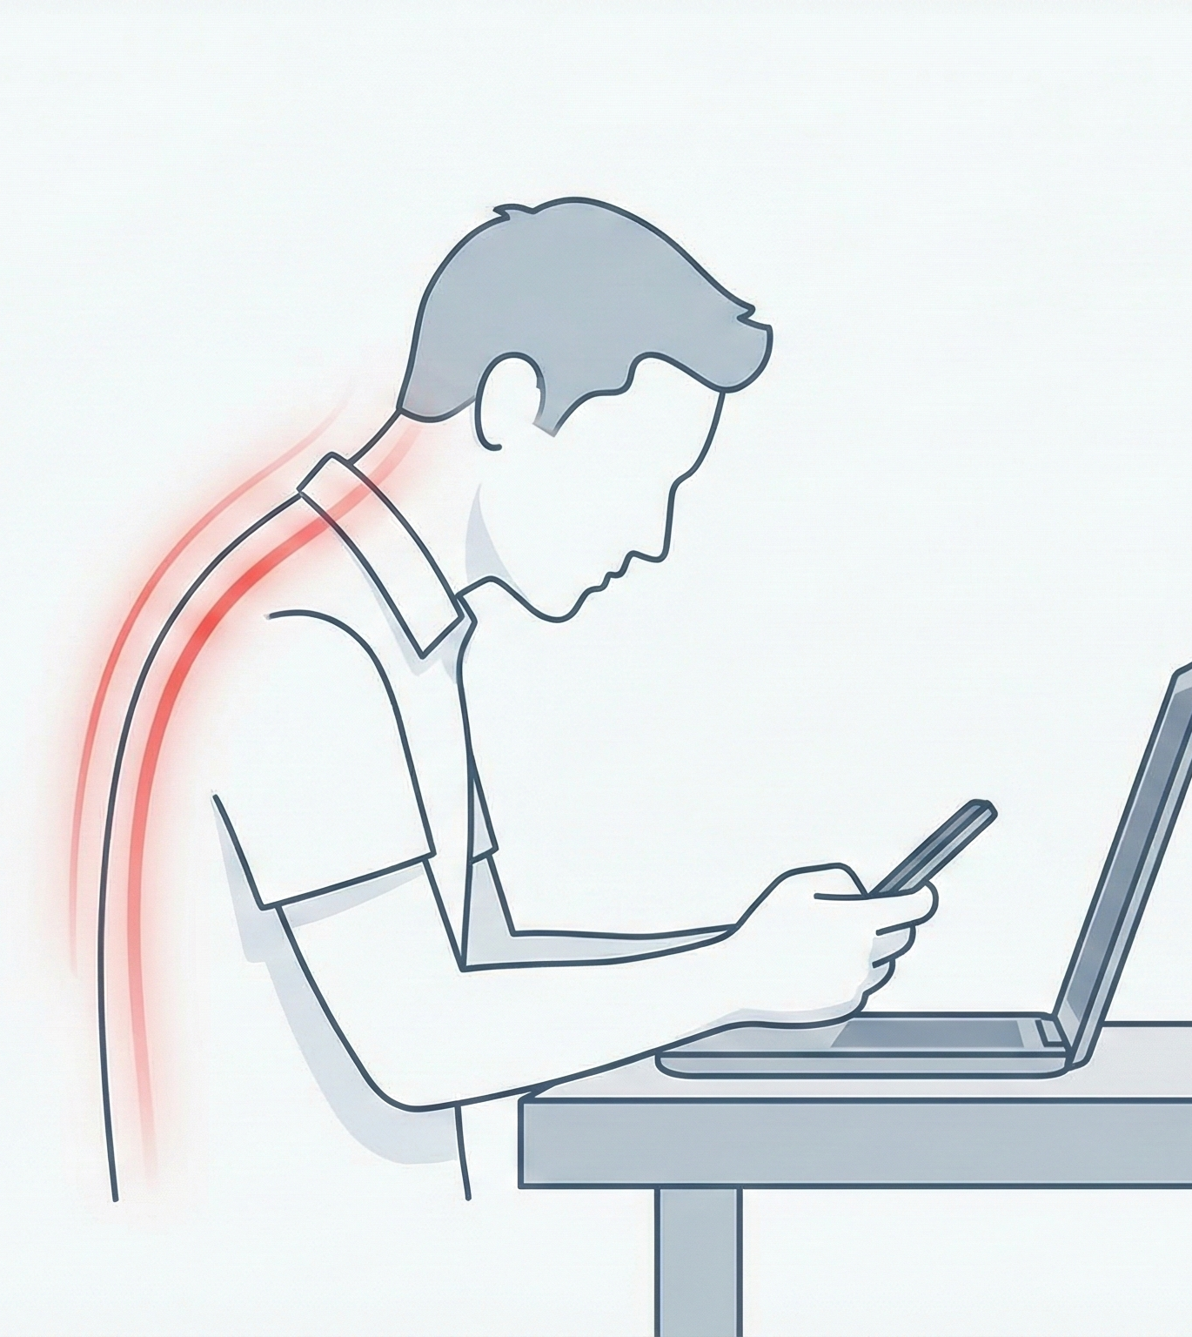
The Cost of Connectivity: A Modern Health Crisis
The "Tech Neck" Phenomenon: Modern lifestyles necessitate prolonged screen time (8+ hours/day).
Health Consequences:
Chronic Musculoskeletal Disorders (MSDs).
Reduced lung capacity and fatigue.
Long-term spinal curvature issues.
Impact: It’s not just physical; it affects productivity and mental focus.

Slide 3
Motivation & Goals
Primary Objective: Develop a robust, real-time detection and correction system.
Core Values:
Health & Wellness: Provide actionable feedback to prevent long-term damage.
Accessibility: Leverage the ubiquity of smartphones (no expensive hardware required).
Ergonomics: Personalized suggestions based on individual body mechanics.

Slide 4
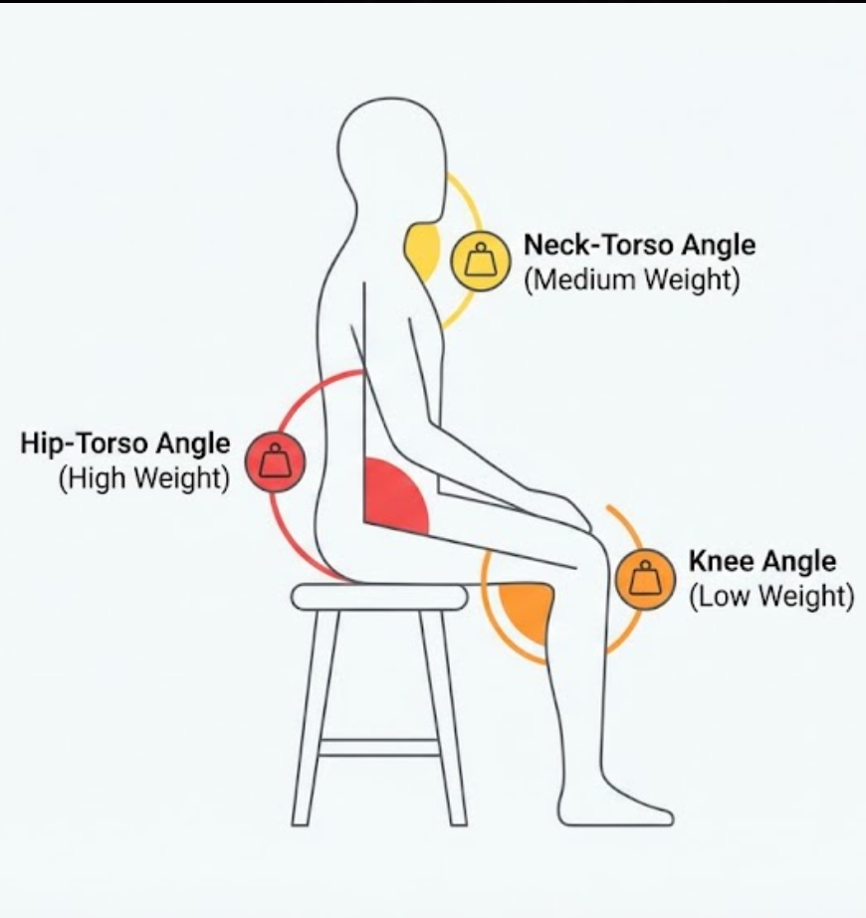
Core Logic: The Angle Approach
Biomechanical Focus: We calculate angles at three critical joints:
Neck-Torso Angle (Cervical Spine load)
Torso-Hip Angle (Lumbar support)
Knee Angle (Leg position)
Scoring Mechanism:
Each joint is assigned a weight based on medical priority (e.g., Back > Neck > Knee).
Weighted deviation determines the final "Posture Score."

Slide 5
Why Angles? (Design Philosophy)
The Problem with Raw Key points:
Variance in camera distance (user standing near vs. far).
Variance in camera orientation (tilted phone).
Variance in body size (height/width of the user).
The Solution:
Angles are invariant to scale and rotation.
Ensures the system works universally across different setups and body types.

Slide 6
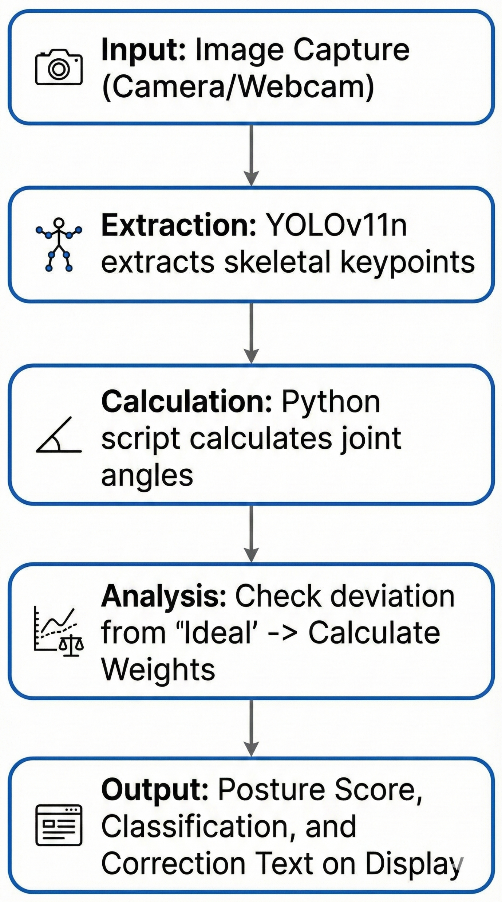
System Pipeline
Input: Image Capture (Camera/Webcam).
Extraction: YOLOv11n extracts skeletal key points.
Calculation: Python script calculates joint angles.
Analysis: Check deviation from "Ideal" -> Calculate Weights.
Output: Posture Score, Classification, and Visual Correction.

Slide 7
Data Collection & Preprocessing
Key point Extraction: Utilizing YOLOv11 for state-of-the-art speed and accuracy.
Targeted Features: Focusing on the three biomechanically important angles (Knee, Hip, Neck).
Data Cleaning:
Confidence Threshold: Any key point with a confidence score (< 0.75 is discarded.
Reasoning: Prevents inaccurate angle calculations caused by occlusion or motion blur.

Slide 8
Initial Attempt: The Random Forest Approach
Method: Trained a Random Forest Classifier on calculated angles.
Dataset: ~300 images labeled with various postures.
Result:
Performed well on Train/Test split.
Failed in Real-World Testing.
Why? It lacked personalization. It assumed "Good Posture" looks the same for everyone.

Slide 9
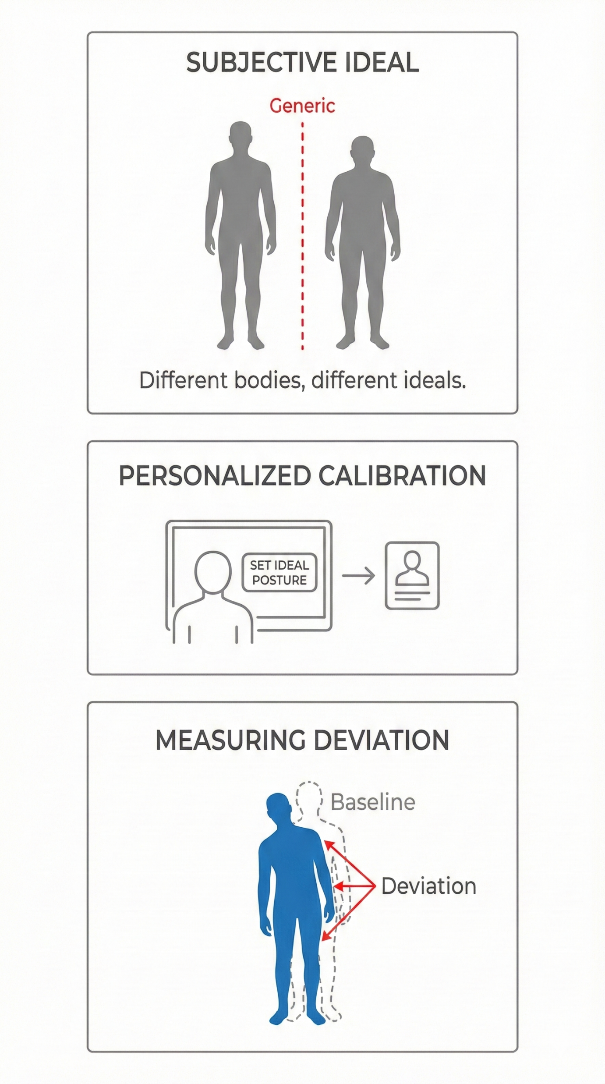
The Pivot: Personalized Calibration
Key Insight: Anatomical differences mean "Ideal Posture" is subjective.
What is comfortable/straight for Person A might be a deviation for Person B.
The Solution: Personalized Calibration.
Concept: Ask the user to sit in their ideal posture first. All subsequent frames are measured as deviations from this specific user's baseline.

Slide 10
Implementation Phase: Weighted Deviation (Heuristic)
Mechanism:
Capture User's Ideal Coordinates.
Calculate Deviation of current frame vs. Ideal Frame.
Weighted Scoring:
High Priority: Back Joint.
Medium Priority: Neck Joint.
Lower Priority: Knee Joint.
Normalization: Deviations are scaled to a 0-100 score (0 = Max Deviation, 100 = Perfect Alignment).

Slide 11
Advanced Implementation: LightGBM Integration
Goal: Move beyond simple heuristics to robust Machine Learning.
What is LightGBM? A gradient boosting framework that uses tree-based learning algorithms.
Known for:
Faster training speed and higher efficiency.
Lower memory usage.
Better accuracy than Random Forest for this specific tabular data (angles).

Slide 12
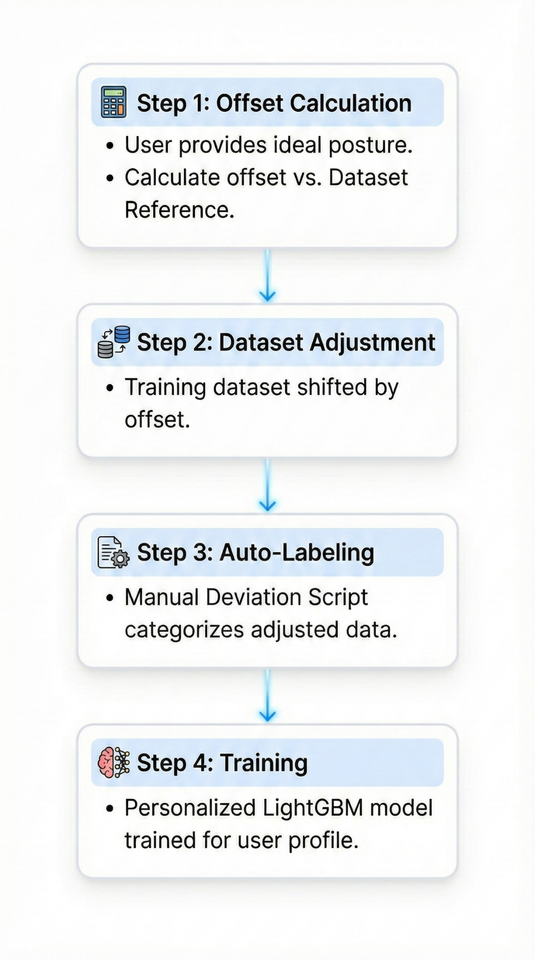
The Personalized Training Workflow
Step 1: Offset Calculation:
User provides their ideal posture.
System calculates the offset between User's Ideal and the Dataset's Reference Ideal.
Step 2: Dataset Adjustment:
The entire training dataset is mathematically shifted by this offset.
Step 3: Auto-Labeling:
The "Manual Deviation Script" runs on this adjusted data to categorize postures.
Step 4: Training:
A personalized LightGBM model is trained specifically for this user profile.

Slide 13
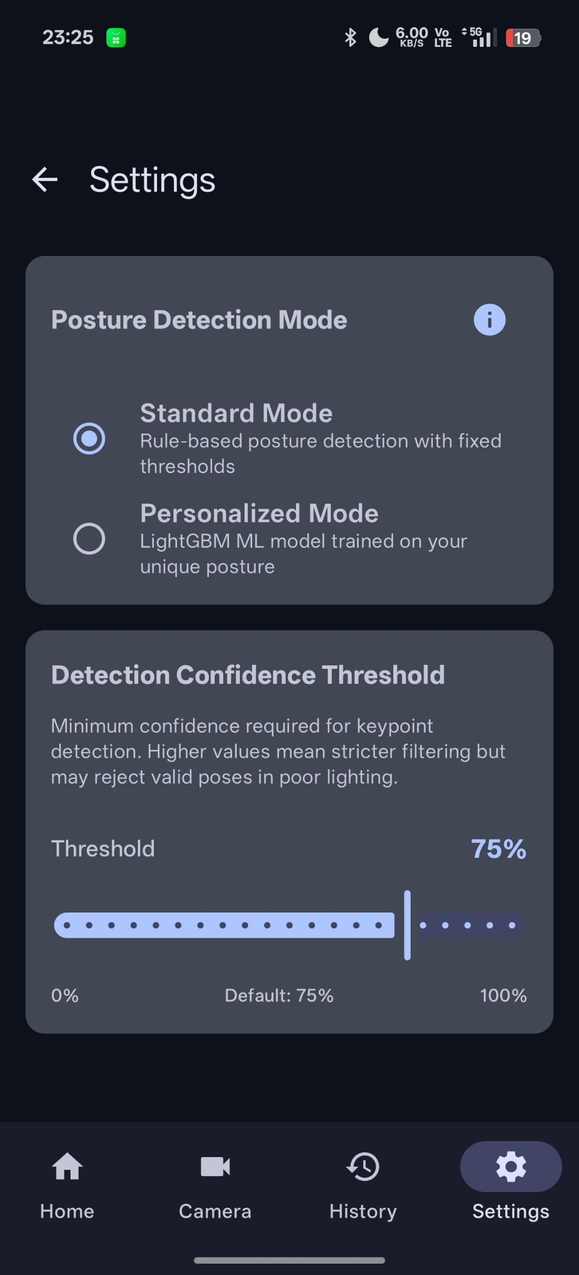
User Choice & Efficiency
Hybrid Model:
User can select Manual Deviation (Heuristic) or Personalized LightGBM (ML).
One-Time Training:
Once trained, the model weights are saved.
User does not need to recalibrate or retrain in future sessions.

Slide 14
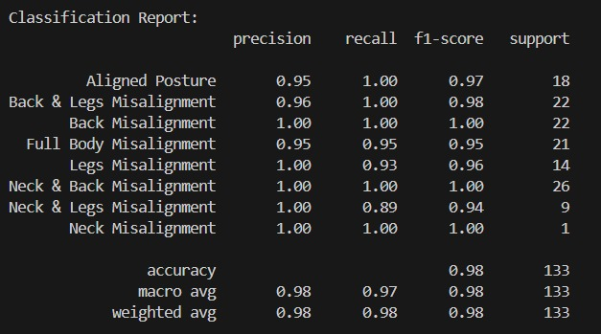
Model Evaluation
Performance Highlights
98% Accuracy: Robust performance on personalized test data.
1.00 Precision: Zero false alarms for critical back & neck issues.
High Granularity: Successfully distinguishes 8 distinct posture states with >95% confidence.

Slide 15
Android App Features
Personal Calibration: One-tap setup for ideal reference.
Real-Time Analysis: Live camera feed with skeleton overlay.
Posture Score: 0-100 quantitative metric.
User Profiles: Switch between different users seamlessly.
Analytics Dashboard:
History: Review past sessions.
Trend Graph: Visualize fatigue over time.
Session Metadata: Duration, start time, data points.
Tech Stats: Real-time NPU/CPU runtime and confidence scores.

Slide 16
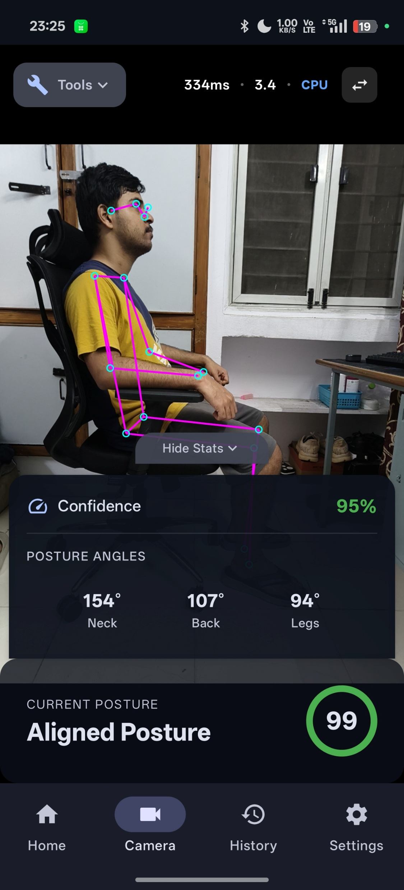
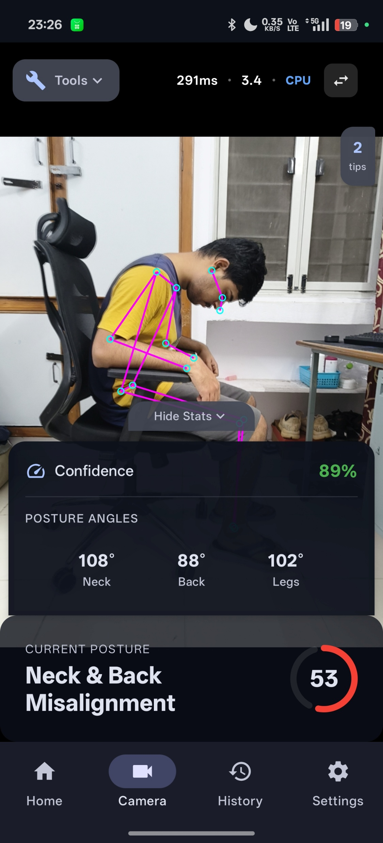
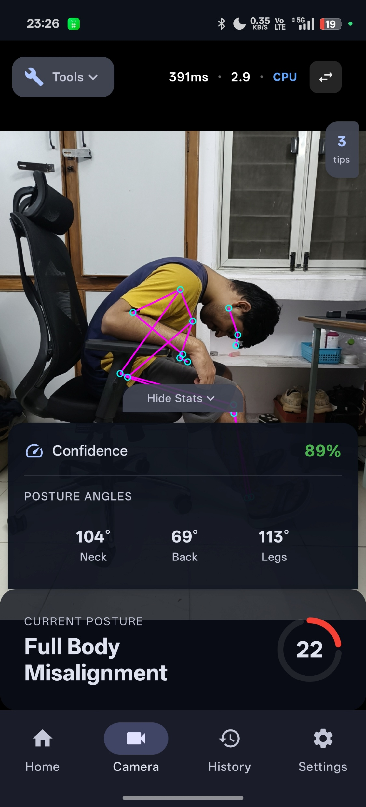
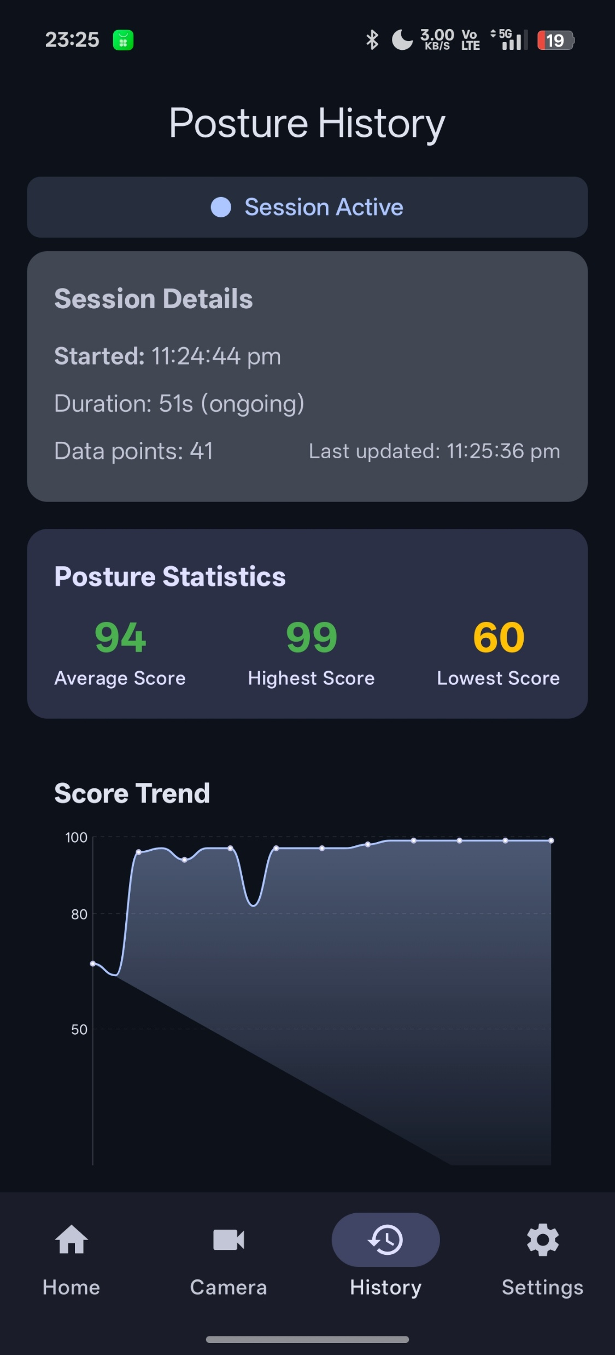

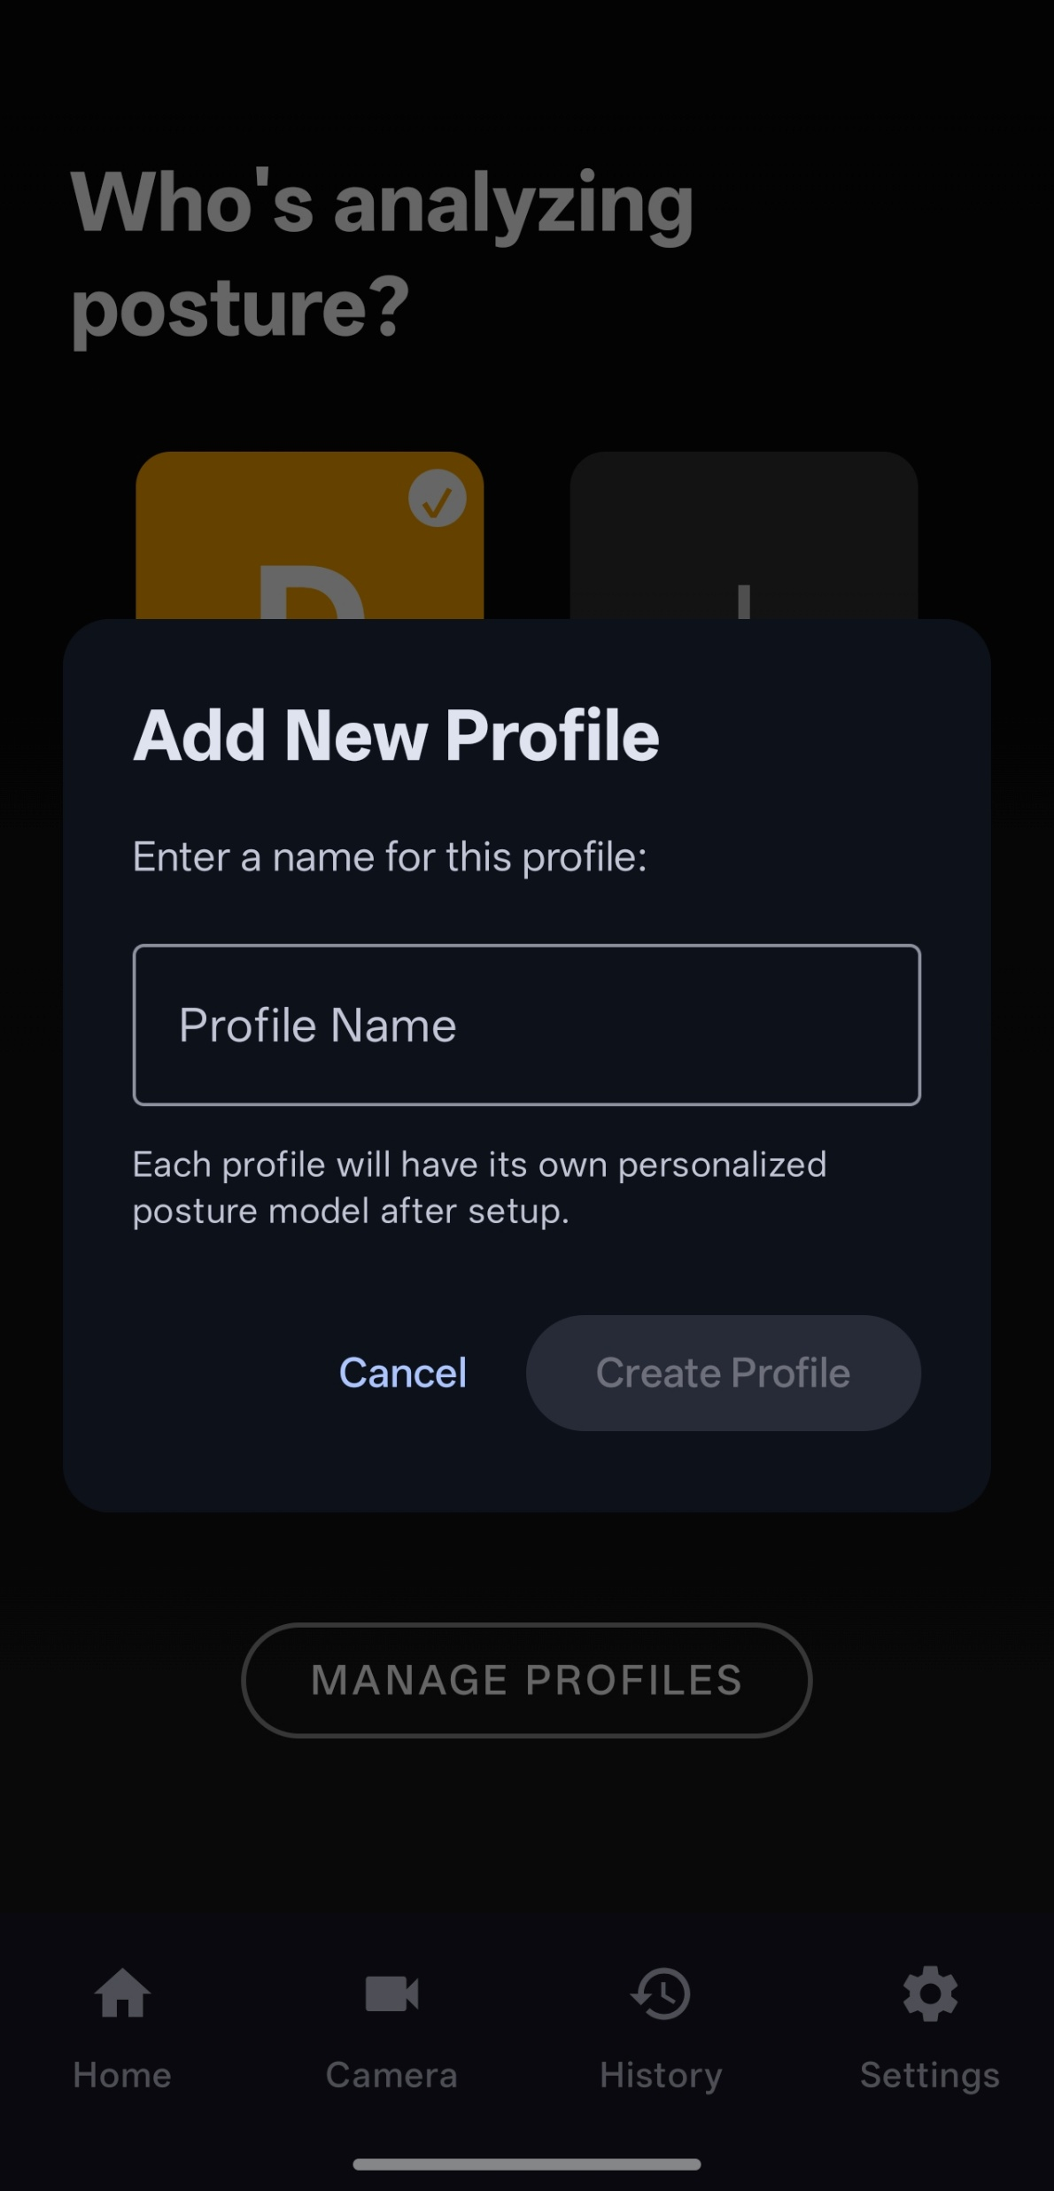
Android App Snapshots

Slide 17
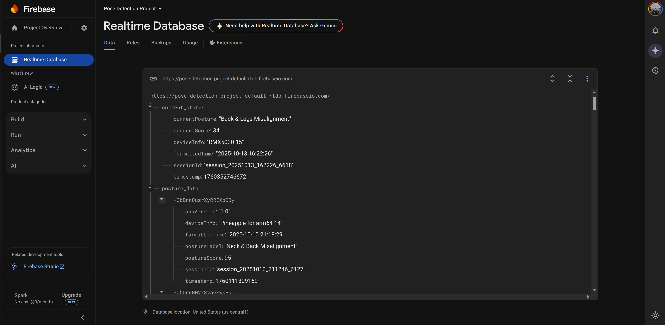
Extended Architecture (Webcam & Database)
Webcam Integration:
Flow: Webcam -> Python Script -> Local Server -> Android App -> YOLOv11.
Benefit: Allows desktop monitoring for office workers. 30 FPS real-time streaming.
Firebase Integration:
Data logging for long-term tracking.
(Include snapshot of the JSON node structure/Database entry).

Slide 18
Performance Benchmarks

Slide 19
Thank You!
Engineers Without Sleep

